Slide 1
MAJOR PROJECT – AIML-B02
Department of Artificial Intelligence and Machine Learning
AI-Driven Enterprise Knowledge Digital Twin using Agentic AI and Hybrid RAG
Intelligent knowledge retrieval, role-based access control, and department-specific enterprise search assistants.
PROJECT GUIDE TEAM MEMBERS
Dr. K. Gnanendra M.Sravanthi(23BQ1A6176)
K.Pujitha siri(23BQ1A6166)
N.Anusha(23BQ1A6191)
K.Sujith(23BQ1A6160)

Slide 2
Introduction & Background
Multi-Document Silos
Productivity Bottlenecks
Confidentiality Boundaries
Enterprise organizations store vital intellectual property across disconnected repositories, including technical PDFs, Word policies, financial spreadsheets, and internal wikis.
Employees spend substantial working hours manually searching through unindexed departmental directories just to locate standard operational answers.
Distinct business units like Human Resources, Engineering, and Finance maintain strictly separate records requiring uncompromised data segregation.
Project Scope: Developing an intelligent enterprise digital twin assistant that interprets natural language queries, executes hybrid keyword-semantic retrieval, and enforces granular RBAC.

Slide 3
Problem Statement
Fragmented Repositories
Inefficient Manual Search
Security Vulnerabilities
Accuracy Deficits
Critical knowledge is scattered across hundreds of unstructured documents with zero centralized indexing or cross-reference capabilities.
Standard keyword lookups fail to capture contextual semantics, forcing staff to read through entire documents manually.
Lack of automated role verification risks unauthorized access to sensitive financial sheets and confidential HR employee records.
Generic LLMs lack enterprise grounding, leading to hallucinations and unverified citations on critical operational policies.
Core Need: A unified, secure, and context-aware knowledge retrieval platform engineered specifically for multi-department enterprise workflows.

Slide 4
Project Objectives & Goals
Intelligent Enterprise Assistant
Natural Language Processing
Deploy a digital twin assistant capable of answering complex internal queries instantly with verifiable source citations.
Enable conversational employee queries without requiring complex SQL syntax or rigid keyword matching strings.
Advanced Hybrid RAG Pipeline
Role-Based Access Enforcement
Merge BM25 keyword precision with Qdrant vector semantic search, optimized via Reciprocal Rank Fusion and rerankers.
Integrate strict RBAC protocols ensuring users only access documents authorized for their specific department.
Target Outcome: Maximize retrieval relevancy, minimize hallucinations, and streamline cross-departmental knowledge sharing securely.

Slide 5





Technology Stack
Frontend
Backend
Databases
AI & Retrieval
Monitoring
React, Vite
Python, FastAPI
PostgreSQL, Qdrant
GPT-4o-mini, BGE, BM25s, RRF, Cross-Encoder
RAGAS, LangSmith
Modern, scalable technology stack engineered for high-performance enterprise RAG.

Slide 6
System Architecture Flow
User Query
React / Vite
FastAPI Backend
Auth & RBAC
Natural Language Input
Frontend Interface
REST API & Endpoints
Permission Validation
Hybrid Retrieval
RRF Fusion
Reranker
GPT-4o-mini
BM25 + Qdrant Vector Search
Reciprocal Rank Fusion
Cross-Encoder Precision
Answer + Source Citations
PostgreSQL: User accounts & document metadata
Qdrant: High-dimensional vector embeddings
Knowledge Source: Enterprise department documents

Slide 7

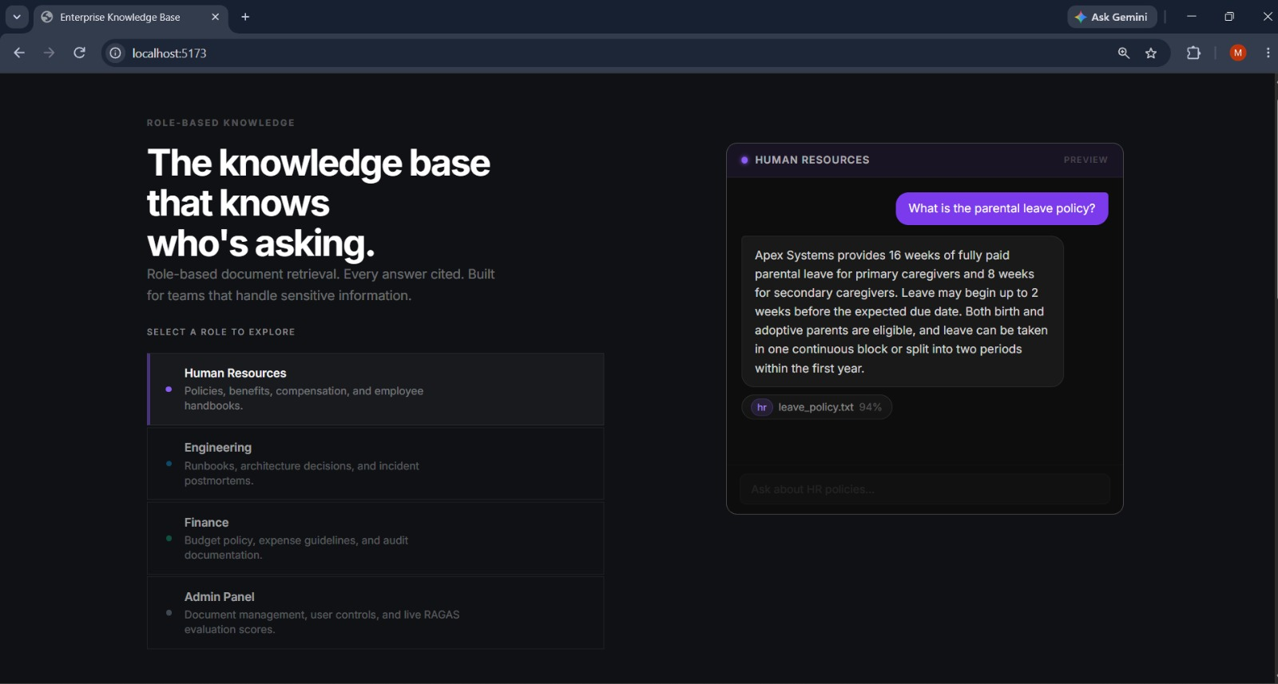
Application Home Page
Project Introduction
Centralized portal introducing the enterprise digital twin assistant.
Department Selection
Dedicated navigation cards for HR, Engineering, and Finance workspaces.
Admin Panel Access
Secure authentication gateway leading to administrative controls.
Technology Overview
Summary of underlying AI models, vector databases, and RAG frameworks.
Localhost landing page providing intuitive user onboarding and workspace routing.

Slide 8
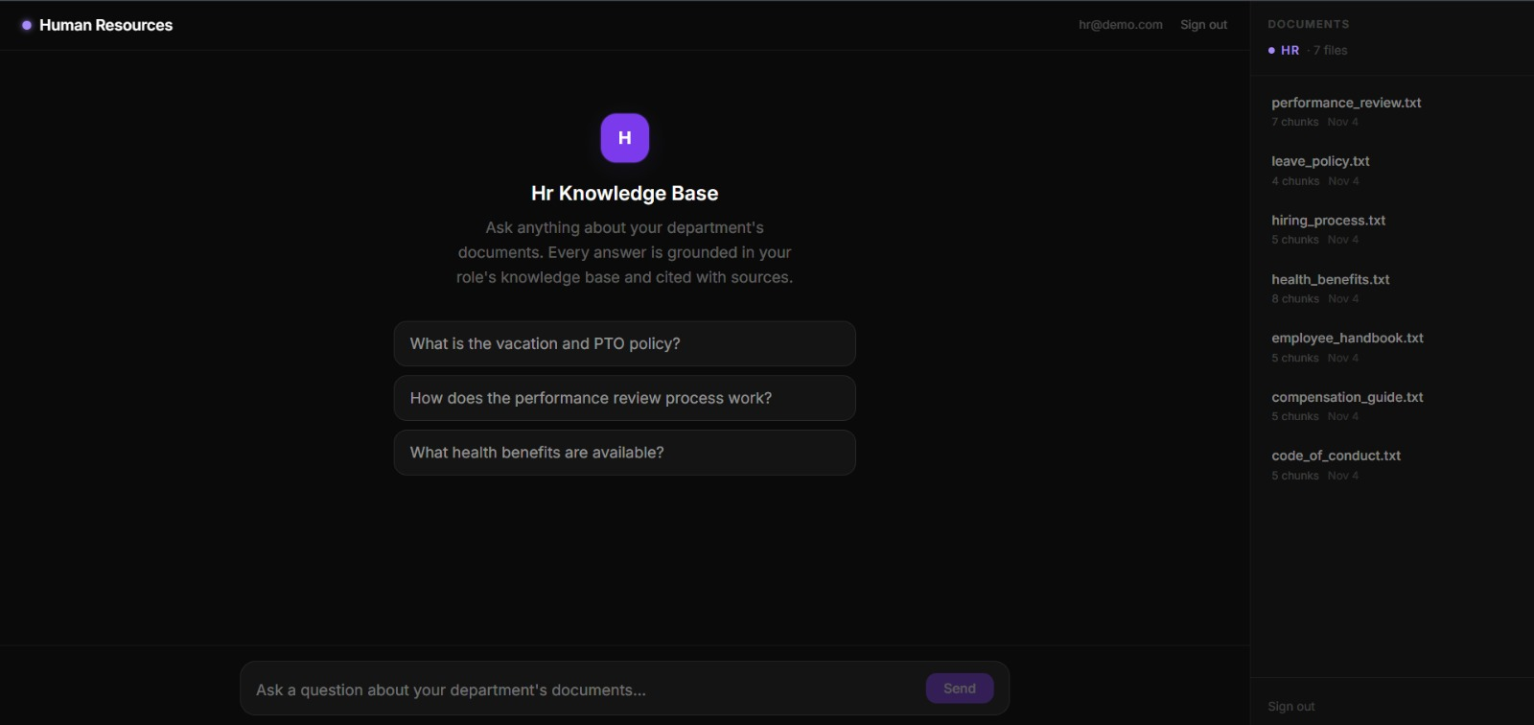
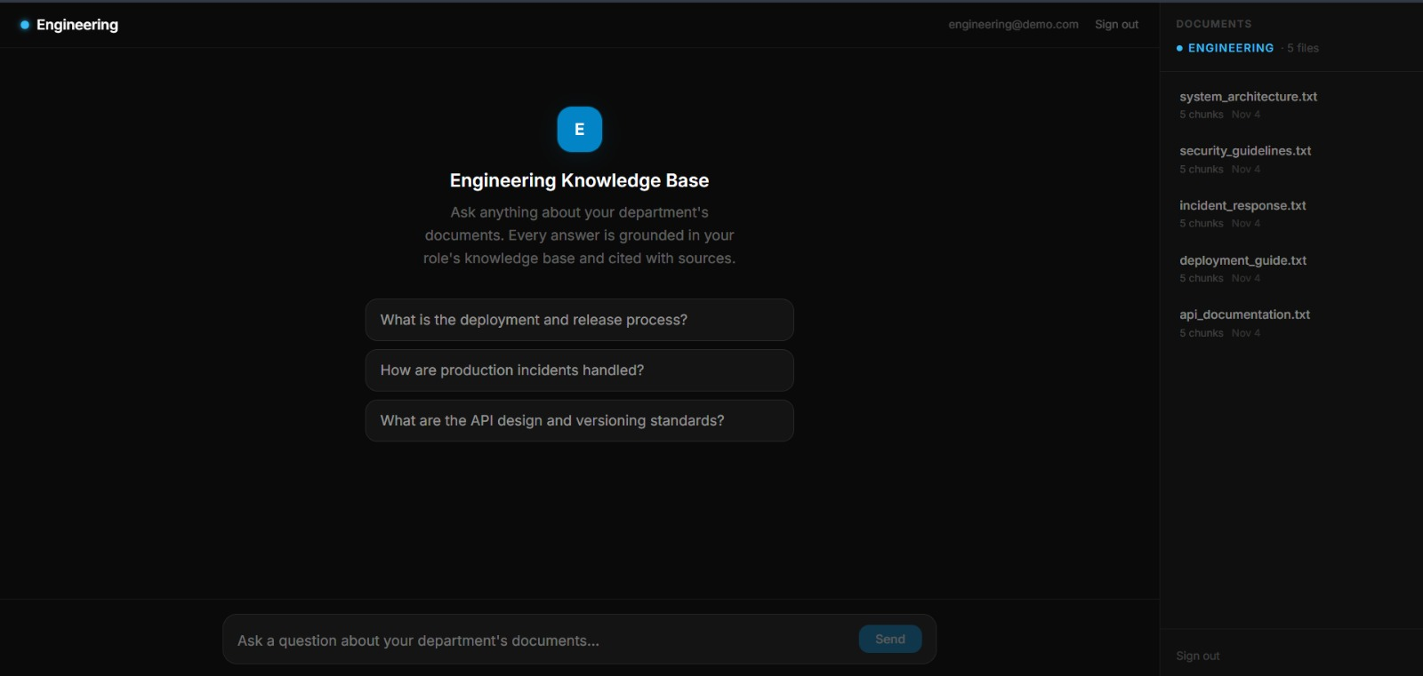
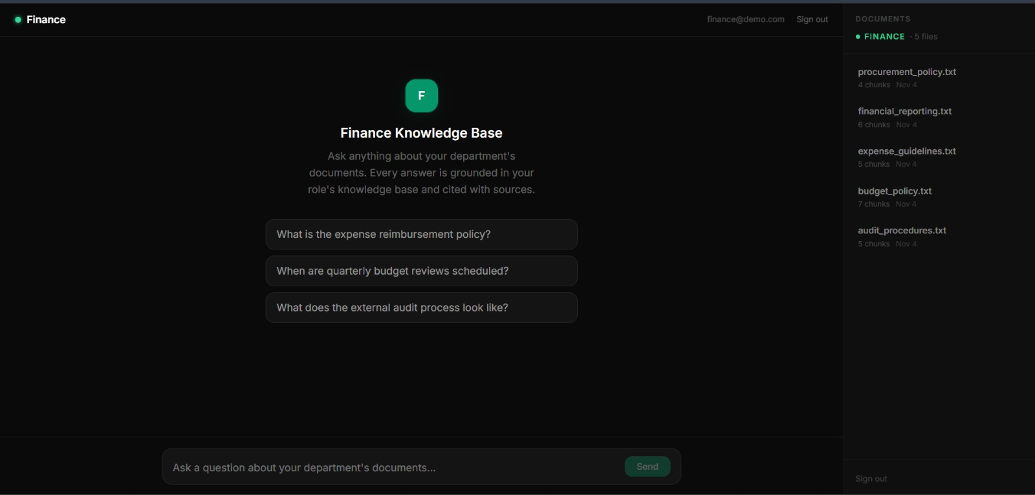
Department-Wise Chat Interfaces
HR Workspace
Engineering Workspace
Specialized interface for employee handbooks, leave policies, onboarding procedures, health benefits, and performance review guidelines.
Technical repository assistant for system architectures, deployment playbooks, API documentation, and security protocols.
Finance Workspace
Secure financial assistant providing instant insights into departmental budgets, expense reports, and compliance guidelines.
Dept Authentication
Natural Language Chat
Prompt Suggestions
Source Document Viewer

Slide 9
Role-Based Access Control (RBAC) Architecture
Departmental Data Isolation
Secured Vector Filtering
Administrator Governance
Ensures HR personnel access personnel records only. Engineering and Finance staff are strictly partitioned from querying sensitive cross-department confidential filings.
The backend search pipeline injects mandatory metadata filters into Qdrant vector queries, restricting retrieval exclusively to documents matching the user's role.
System administrators retain full auditing oversight, managing user account activations, role promotions, and global permission parameters.
Enterprise Guarantee: Zero data leakage between departments with verifiable audit trails for all queries.

Slide 10
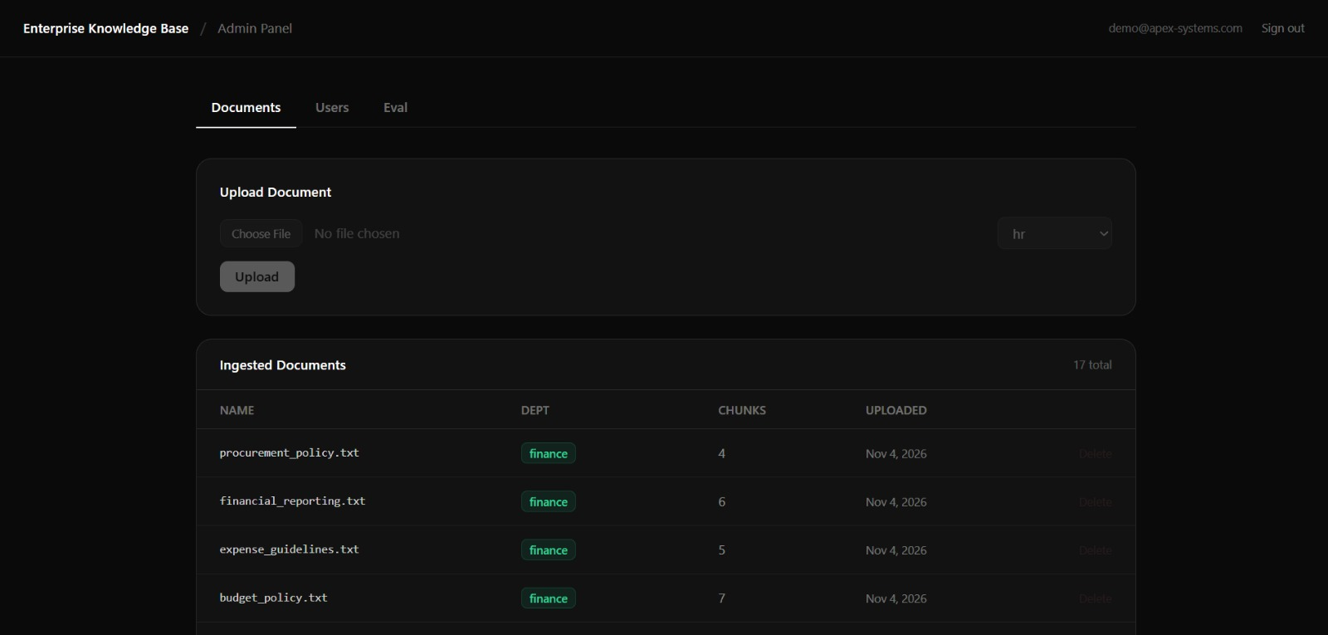
Admin Panel Control
Document Management
Inspect uploaded enterprise files, department tagging, chunk counts, and file uploads/deletions.
User Account Control
Manage employee accounts, assign departmental roles, and toggle user active/inactive statuses.
RAG Evaluation Suite
Monitor Faithfulness, Answer Relevancy, Context Recall, and Context Precision metrics via RAGAS.
Centralized administrative dashboard ensuring high retrieval fidelity and secure access.

Slide 11
Hybrid RAG Workflow
STEP 01
STEP 02
STEP 03
STEP 04
Ingestion
Retrieval
Fusion & Rerank
Generation
Upload, extraction, chunking, & vector embedding.
BM25 keyword search + Qdrant semantic vector search.
RRF result merging & Cross-Encoder precision reranking.
GPT-4o-mini produces natural language answers with sources.
BM25: Keyword Precision
Vector Search: Semantic Depth
RRF: Robust Fusion
Reranker: High Relevancy

Slide 12
Current Status & Future Work
Currently Explored & Built
Under Active Testing
Future Expansion
•
End-to-end hybrid RAG question-answering pipeline
•
Complete FastAPI backend and vector db integration
•
Local development environment fully configured
•
Landing page and workspace routing operational
Source citation verification and preview rendering
Fine-tune Cross-Encoder reranker accuracy
•
•
•
HR, Engineering, and Finance UI panels active
Role-based access control permission validation
Implement real-time document chunk previews
•
•
•
Admin panel interface built with document lists
RAGAS evaluation metrics benchmarking
Deploy containerized production build (Docker)
•
•
Solid architectural foundation established with active optimization of the RAG pipeline.

Slide 13
Conclusion
The project successfully establishes a centralized AI-powered enterprise knowledge assistant utilizing Hybrid RAG.
Role-based access control guarantees strict departmental information security and compliant data sharing.
Thank You! — AIML-B02 (Guide: Dr. K. Gnanendra)

